Slide 1
Website Ad Click Prediction
Bhavin Panchani

Slide 2
Introduction
In today’s world, visiting websites has become an integral part of our lives.
People on average spend 24 hours per week online
The Internet or World Wide Web is quickly becoming the most effective way for businesses to advertise their products or services to consumers.
Web sites such as search engines or small sites that sell advertisement space for sponsoring are profiting highly from the increase of advertising on the internet.

Slide 3
Our Goal
In this project we wanted to develop a classification model which can predict whether a user will click on an ad on a website or not.
With the use of data like age, gender, income, daily internet usage and daily time spent on site.
This data will help companies more accurately advertise, wasting less money while making even more
Consumers benefit from seeing ads they are more likely to be interested in

Slide 4
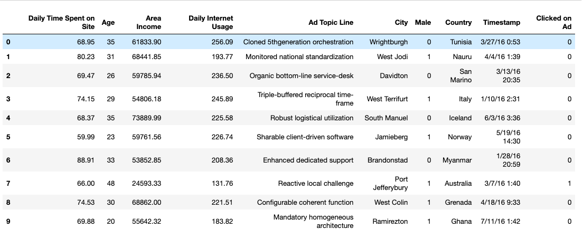
Data source
https://www.kaggle.com/fayomi/advertising
Dataset Created by Jose Portilla.
Explore the data to find predict who is more likely to click the ad.

Slide 5
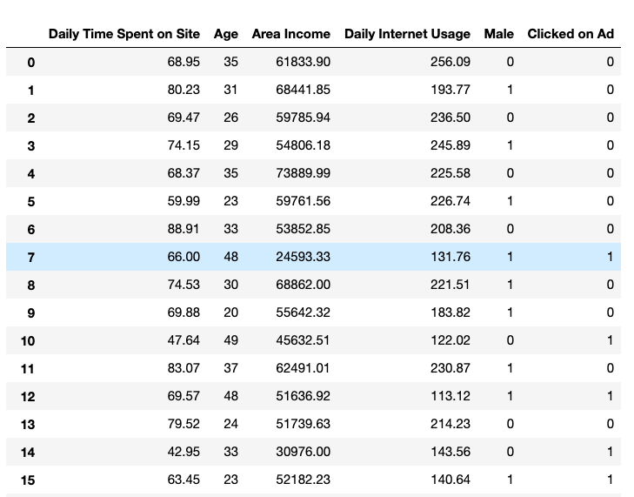
Numerical Data

Slide 6
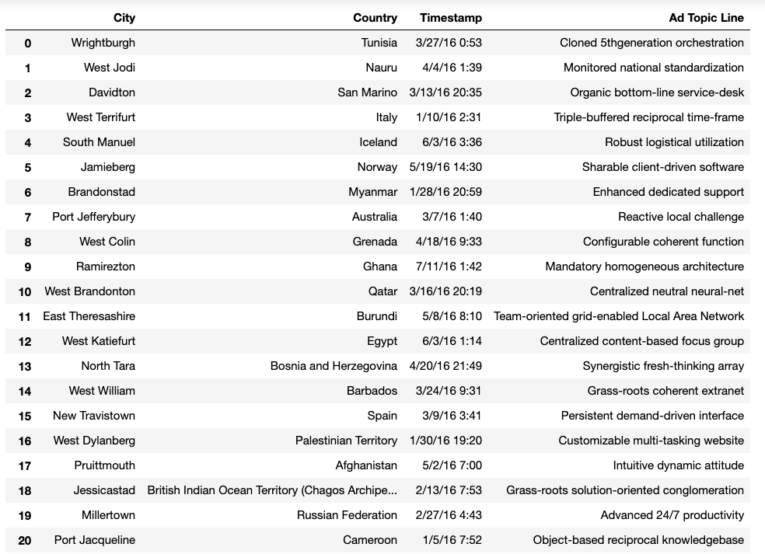
Categorical data

Slide 7

Get rid of the categorical columns
There are total 1000 records in our dataset
There are lot of unique values in this categorical columns
Little overlap
Even if we try to convert those categorical values into numeric values
There will be no pattern in those columns that will train our models any better and get a better accuracy
Ultimately decided to drop these columns

Slide 8
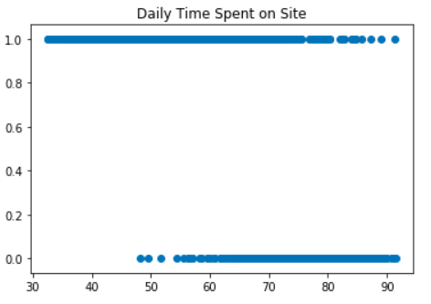
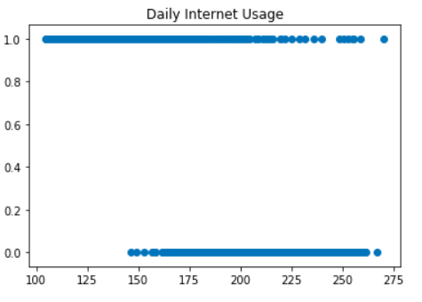
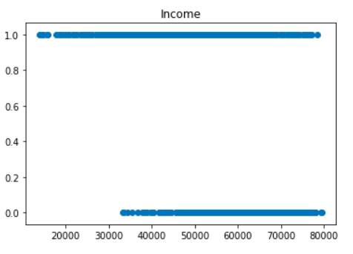
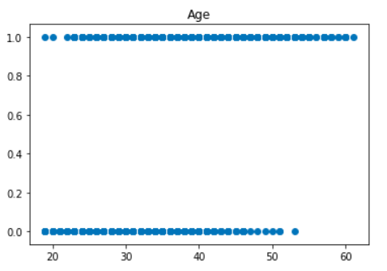
Visualizing the data Scatter plot:
Minutes
Minutes
1 = Clicked On Ad
0 = Not Clicked On Ad
Dollars
Years

Slide 9
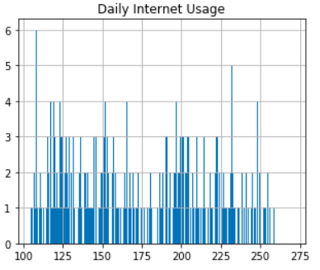
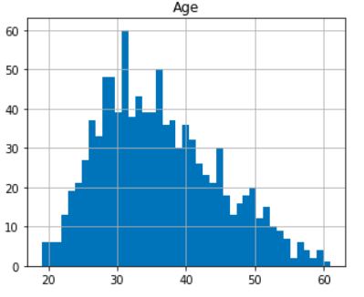
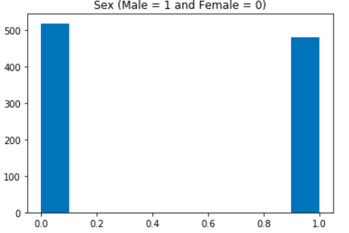
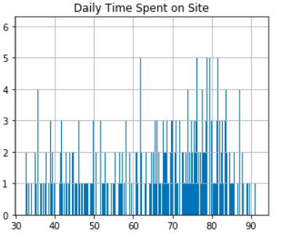
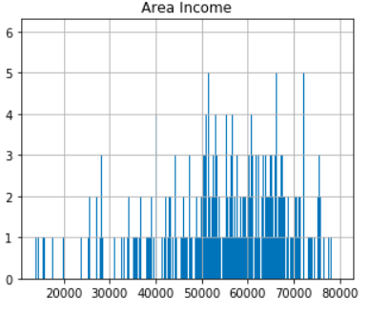
More graphs
Years
Minutes
Minutes
Dollars

Slide 10
We can see the trend
From the graphs, we can assume that:
Female
Age group around 31 to 40
Spends 62 to 78 minutes on the site
And whose daily internet usage is about 100 to 200 minutes
Are more likely to click an ad on the site

Slide 11
Models
Logistic regression (creating from scratch)
Logistic regression (sklearn library)
Adapted
Neural Network (Keras library)
Adapted
Compare the accuracy

Slide 12

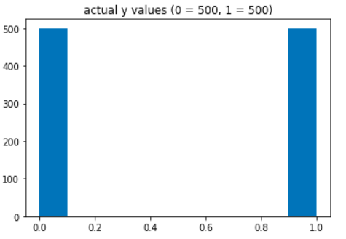

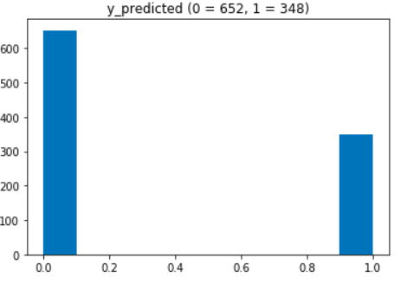
Logistic Regression (from scratch) Accuracy 84.40%
Comparing predicted values with actual values
Here
1 = user clicked the ad
0 = user DID NOT click the ad

Slide 13
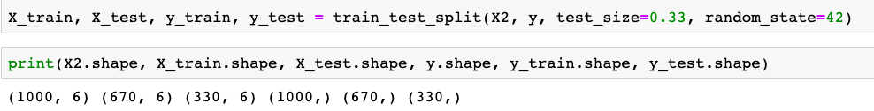
Splitting the training and testing data
Split the data
Assigned 67% of the data for training the model
And 33% of the data for testing

Slide 14
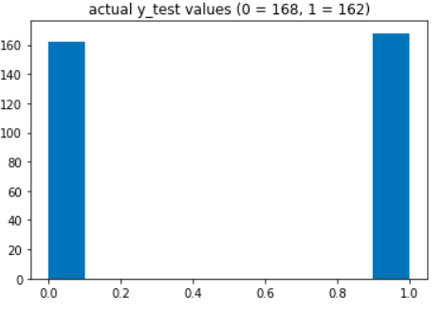


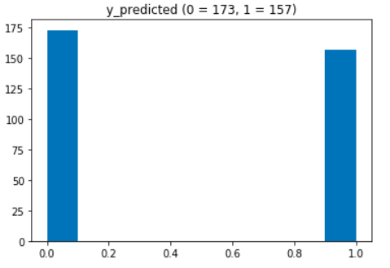
Logistic regression (sklearn library) Accuracy 94.85%
Comparing predicted values with actual values
Here
1 = user clicked the ad
0 = user DID NOT click the ad

Slide 15
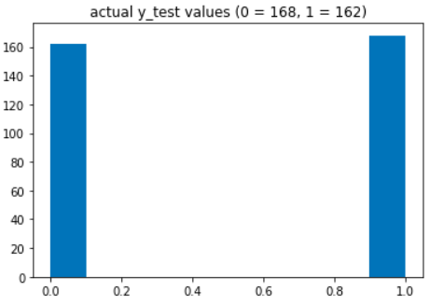


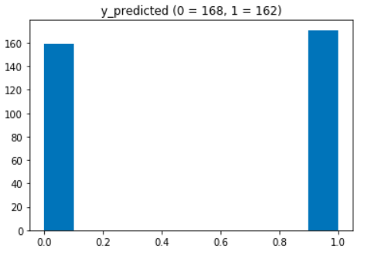
Neural Network Accuracy 96.06%
Comparing predicted values with actual values
Here
1 = user clicked the ad
0 = user DID NOT click the ad

Slide 16
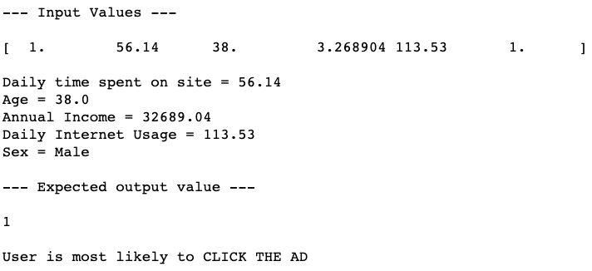
Generate random test data
Generate random data from Testing data
As we know what the output is going to be.
We can use these input values in our model to get the predicted value.
And we can compare the predicted value with the actual value.
y_test value

Slide 17
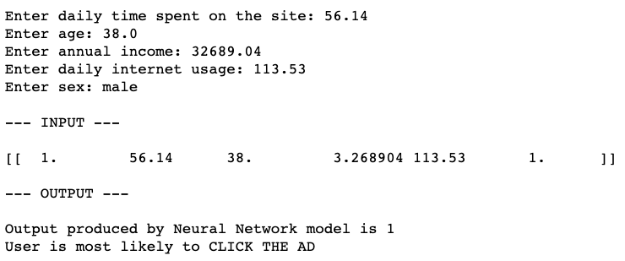
Prediction for new/test data
Here we are asking for new or test data.
Put the input values in our trained neural network model.
And produce an output based on our trained neural network model.

Slide 18
Project Summary
We created one logistic regression model from scratch.
Used one library for logistic regression and
One library for neural network.
The results shows that neural network is the best model and does a better job of predicting the values than logistic regression model.
The accuracy we got from neural network is closer to 100 percent.

Slide 19
Conclusion & Takeaways
Using an improved logistic regression, advertising accuracy increased 10.45%
Which correlates to an extra 10% efficiency and profit from the company’s advertising efforts
Neural network increased accuracy even further, from 94.85% to 96.06%
For a company that spends $1,000,000 on advertising, they are saving $12,100 by not wasting it on ineffective methods
Scaling this project, if hundreds of companies utilized our method, millions of dollars could be saved
This project helps save everyone involved both time and money, two of the most valuable aspects of life

Slide 20
Thank You

